Slide 1
Bloomberg-Style Financial Performance & CFO Analytics
Financial Performance, Revenue Drivers & Profitability Investigation | FY2016–FY2023
Your name : Challa Harika
Data Analyst Intern
Tools: Python | Excel | Power BI | DAX
Batch : 1 Apr 2026, DA/BA Batch

Slide 2
Business Problem :
Why was this analysis needed?
Raw financial extracts are not immediately analysis-ready.
Multiple formats, missing values and financial notation can create reporting errors.
Management needs to understand revenue performance, profitability and cost drivers.
The objective is to move from raw financial data → reliable KPIs → business insights.
From Raw Data to Decision-Ready Analysis:
Excel / CSV
↓
Python + Pandas
↓
Data Cleaning
↓
Validation
↓
Clean Financial Tables
↓
Power BI Data Model
↓
DAX Measures
↓
Dashboard
↓
Business Analysis

Slide 3
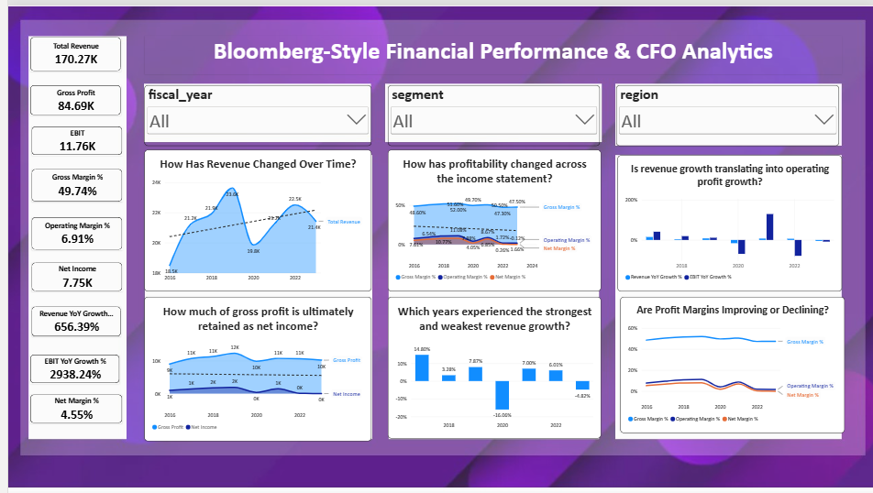
CFO Overview

Slide 4
KPI’s
Revenue : 170.27K
Gross Margin : 49.74%
EBIT : 11.76K
Operating Margin : 6.91%
Net Income : 7.75k
Total Revenue Trend
Finding: Revenue rose from €18.5B FY2016 to €23.6B FY2019, fell to €19.8B in FY2020, recovered to €22.5B in FY2022, then fell to €21.4B in FY2023.
Business Insight: Growth has been volatile and FY2023 remained below the FY2019 peak.
Business Investigation : Drill into product, channel and geography to identify the sources of the FY2020 and FY2023 declines.
Gross Profit vs Net Income
Finding: Gross profit remained relatively strong, while net income fell sharply, reaching negative territory in FY2023.
Business insight: Revenue/gross-profit generation is not translating consistently into bottom-line profit.

Slide 5
Profitability Trend
Finding: Gross margin stayed around 47–52%, but operating and net margins deteriorated substantially after FY2019.
Business insight: The major profitability pressure is below gross profit.
Revenue Growth
Finding: Strongest growth: FY2017 +14.8%. Weakest: FY2020 -16.1%. FY2023 declined 4.8%.
Business insight: Growth momentum has weakened considerably from the earlier period.
Revenue Growth vs EBIT Growth
Finding: FY2022 revenue increased 6%, but EBIT declined approximately 79%.
Business insight: Revenue growth did not translate into operating-profit growth.
Margin Trend
Finding: Operating Margin fell from 11.1% FY 2019 to 1.7% FY 2023; net margin reached -0.1%
Business Insight : Profitability deterioration is much greater than the revenue decline alone.

Slide 6
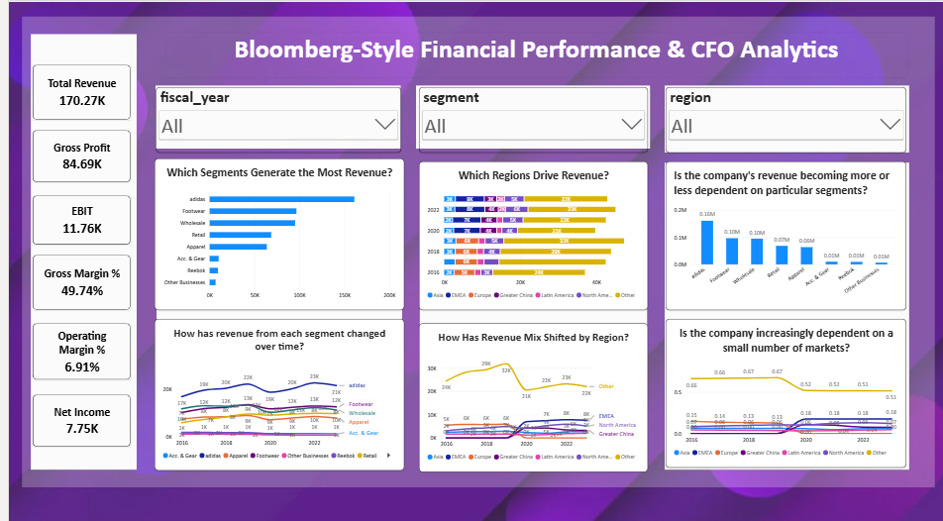
Revenue Analysis

Slide 7
Revenue Analysis
Which Segments Generate the Most Revenue?
Finding: The visual shows adidas, Footwear, Wholesale and Retail as the largest revenue categories, followed by Apparel and Accessories.
Business insight: Footwear is the primary revenue engine and has the strongest long-term growth.
How Has Revenue from Each Segment Changed Over Time?
Finding: Footwear increased from roughly €10.1B to €12.5B, while Apparel and Accessories also recovered after FY2020 but declined in FY2023.
Business insight: Footwear is the strongest long-term product revenue contributor.
Which Regions Drive Revenue?
Finding: The report shows substantial regional differences, with North America, EMEA/Europe and Greater China among the major markets.
Business insight: Revenue performance is geographically uneven.
How Has Revenue Mix Shifted by Region?
Finding: The regional mix changes across the period, with North America and other major regions representing different proportions over time.
Business insight: The company's geographic revenue concentration is changing.
Is Revenue Becoming More Dependent on Particular Segments?
Finding: The visual indicates concentration around major categories, especially adidas and Footwear.
Business insight: The business has meaningful dependence on its core products/brand.
Is the Company Increasingly Dependent on a Small Number of Markets?

Slide 8
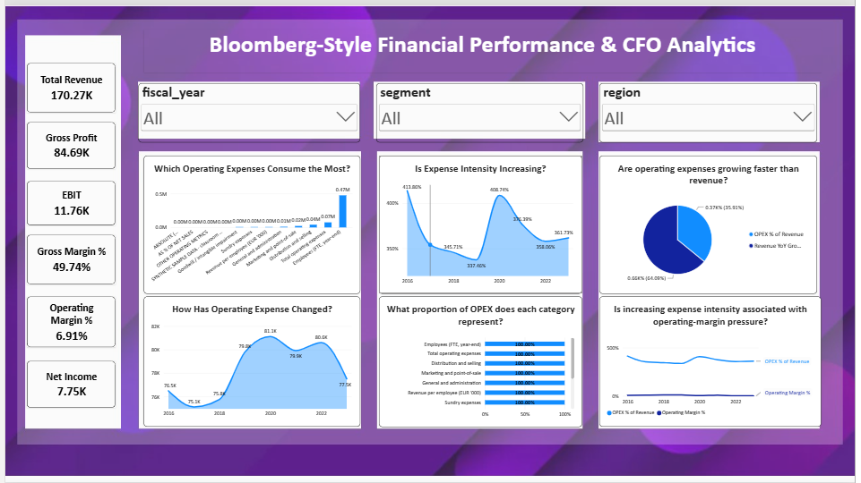
OPEX & Profitability

Slide 9
OPEX & Profitability
Which Operating Expenses Consume the Most?
Finding: Distribution & Selling is the largest operating expense, followed by Marketing and G&A.
Business insight: Distribution & Selling is the primary cost area to investigate.
How Has Operating Expense Changed?
Finding: OPEX fluctuates across the period and remains elevated during the later years.
Business insight: The cost base has not reduced proportionally with revenue weakness
What Proportion of OPEX Does Each Category Represent?
Finding: Distribution & Selling is the dominant OPEX category.
Business insight: Management should focus cost-efficiency efforts on the largest expense pool first.
Investigation: Analyze Distribution & Selling as a percentage of OPEX and revenue over time.
Is Increasing Expense Intensity Associated With Operating-Margin Pressure?
Finding: OPEX/revenue increased from approximately 41.9% in FY2019 to 46.8% in FY2023, while operating margin declined from 11.08% in FY2019 to 1.66% in FY2023.
Are Operating Expenses Growing Faster Than Revenue?
FY2022 is the clearest cost-pressure year: revenue grew 6%, while OPEX grew 15.4%.

Slide 10
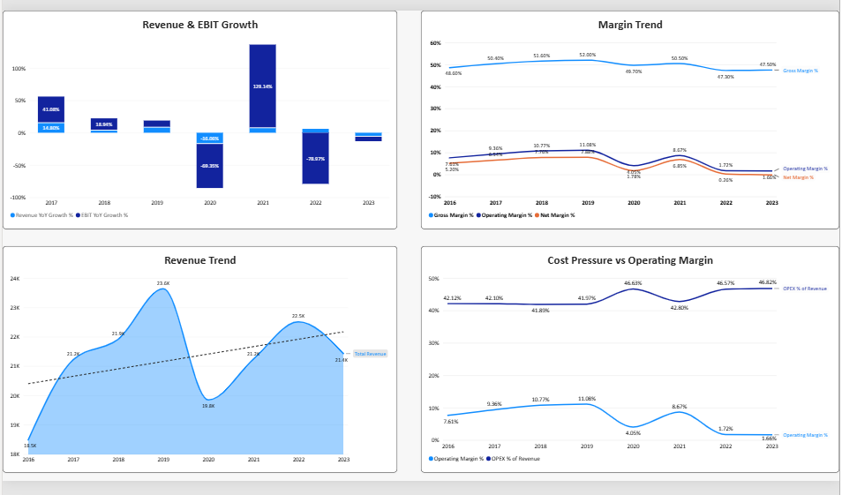
Business Drivers & Investigation Page
Business Drivers & Investigation Page

Slide 11
Business Drivers & Investigation Page
Revenue & EBIT Growth
Finding:
FY2020 Revenue: -16.1%
FY2020 EBIT: -69.3%
FY2021 Revenue: +7.0%
FY2021 EBIT: +129.1%
FY2022 Revenue: +6.0%
FY2022 EBIT: -79.0%
FY2023 Revenue: -4.8%
FY2023 EBIT: -8.3%
Business insight:
Revenue and operating profit are not moving together consistently.
Margin Trend
Finding:
Gross margin remains relatively stable compared with the much larger decline in operating and net margins.
Business insight:
The key problem appears to be operating profitability, not simply revenue generation.

Slide 12
Revenue Trend
Finding: FY2019 was the revenue peak at approximately €23.6B; FY2023 revenue was approximately €21.4B.
Business insight: The business has not returned to its FY2019 revenue peak.
Cost Pressure vs Operating Margin
Finding: Operating margin deteriorated substantially after FY2019 while OPEX intensity remained elevated.
Business insight: Cost structure is a major area for management investigation.

